Slide 1

INCOME INEQUALITY
TEAM SINTRA

Slide 2
BUSINESS UNDERSTANDING

Slide 3
DEFINITION
According to Britannica dictionary, Income Inequality is a disparity in distribution of income between individuals, groups, populations, social class or countries.
Income is the major determinant of quality of life and varies by social factors such as age, sex, race, education etc.
On global level, the richest 1 percent of people in the world receiving as much as the bottom 56 percent in the early 21st century.
https://britannica.com/money/topic/income-inequality

Slide 4
BACKGROUND
Economic inequality can have positive and negative effects on economic growth, social cohesion, political stability and human well being.
Forbes counted a record 2,755 billionaires in the world as of 2021
Meanwhile world bank estimated more than 711 million people globally were living on less $1.90 per day.
Nowadays many people experiencing homelessness or housing insecurity.
The essence of economic equality is how much money the least well off (not secured) make, compared to the most well off (secured one).
www.Investopedia.com/economic-inequality-4845459

Slide 5
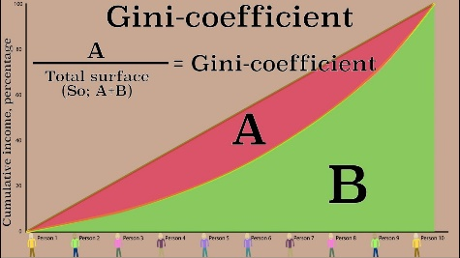
INCOME INEQUALITY INDICATORS
Gini-coefficient
It ranges between 0 and 100. Where 0 indicates income shared equally among all people and 100 indicates extreme situation where one person accounts for all income.

Slide 6
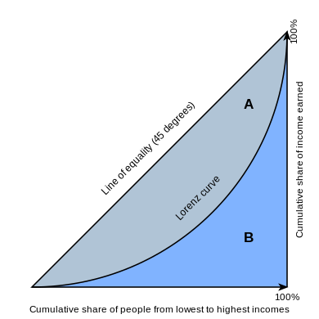
INCOME INEQUALITY INDICATORS
Lorenz curve
Is a graphical representation developed by an American economist Max Lorenz in 1905.
The plot shows what proportion of national income is earned by what percentage of households.

Slide 7
PROJECT OBJECTIVE
The objective of the project is determining individuals weather they are below or above a given Income limit.
Because the income distribution in an even manner among population. If steps are not taken, this problem could continue to grow.
The solution can potentially reduce the cost and improve the accuracy of monitoring key population indicators.
The result will help policy makers to better manage and avoid income inequality globally.

Slide 8
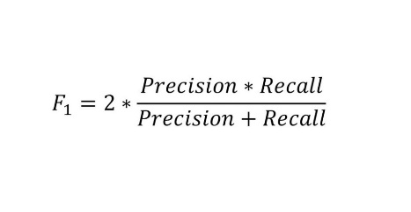
EVALUATION METRIC
For the sake of confidence on our project model success, an evaluation metric is used to determine the achievement called F1 score.
It assess predictive ability of model by examining its performance on each class individually. F1 score ranges between 0 to 1. The closer to 1, the better model.
https://serokell.io/blog/a-guide-to-f1-score

Slide 9
QUESTIONS ASKED
How many people are below the level limit and how many are above the limit ?
Which classes of workers are above the limit ?
Is tax status related to the limit ?
Does citizenship affect the limit ?
How is education distributed over gender ?

Slide 10
TOOLS USED
Since target feature is known, a Supervised Machine Learning model is suitable. Our goal is to classify people on whether they fall below the income limit or above the income limit.
This type of classification is called Binary Classification.
As our data has null records, We used types of machine learning frameworks which can handle the issue.

Slide 11
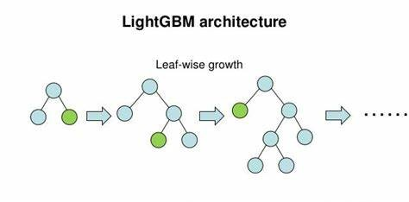
MACHINE LEARNING MODELS
LightGBM
Developed by Microsoft Corporation and works based on tree algorithm and gradient boosting technique and used for binary or multiclass classification.

Slide 12

MACHINE LEARNING MODELS
CatBoost
Developed by Yandex which is a Russian multinational technology company.
Can handle categorical features directly without the need for manual encoding or preprocessing. It uses novel algorithm called ordered boosting.

Slide 13

MACHINE LEARNING MODELS
XGBoost
Like CatBoost, developed by Yandex. It reduces the effect of target leakage and overfitting when dealing with categorical features.
This tool helps to understand how model makes.

Slide 14

MACHINE LEARNING MODELS
Random Forest
Trademarked by Leo Breiman and Adele Cutler
It combines the output of multiple decision trees to reach a single result.
Ease of use and flexibility have fueled its adoption.
It can handles both classification and regression problems.

Slide 15

MACHINE LEARNING MODELS
Decision Trees
In this algorithm data is continuously split into smaller parts until it reaches its class.
It uses the terminologies like nodes, edges and leaf nodes.

Slide 16
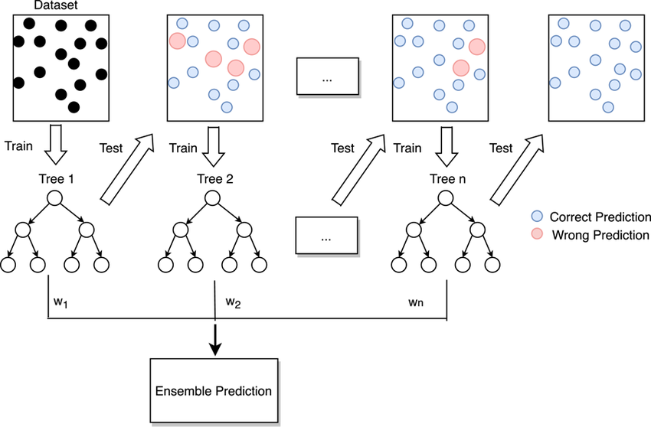
MACHINE LEARNING MODELS
Gradient Boosting Classifier
Used in regression and classification tasks, among others.
When a decision tree is the weak learner, the resulting algorithm is called gradient-boosted trees.
It is s used when the target column is binary.

Slide 17



APPLICATIONS
PYTHON
FastAPI
DOCKER

Slide 18
SCOPE AND SOURCE
The project encompasses 200,000 individuals and utilizes data from Zindi Africa, a competition platform led by Ambassador Emmanuel Koupoh.
The data's quality has been confirmed. It mainly consists of categorical and continuous variables.
The data for this project is stored in CSV format using two separate files: one for training and the other for predicting the target.

Slide 19
Visualizations

Slide 20
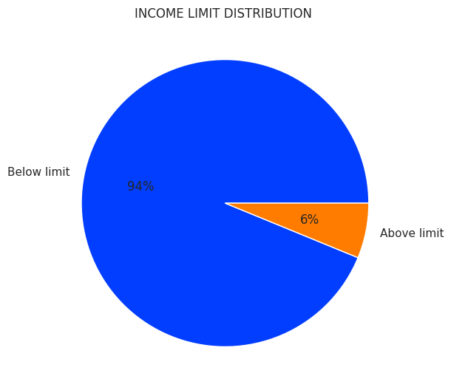
DISTRIBUTION OF INCOME LIMIT
Majority of the population is below the income limit, with 94% of the population.
The income limit is the minimum amount of money that a person or a household needs to meet their basic needs, such as food, clothing, shelter, health, and education.

Slide 21
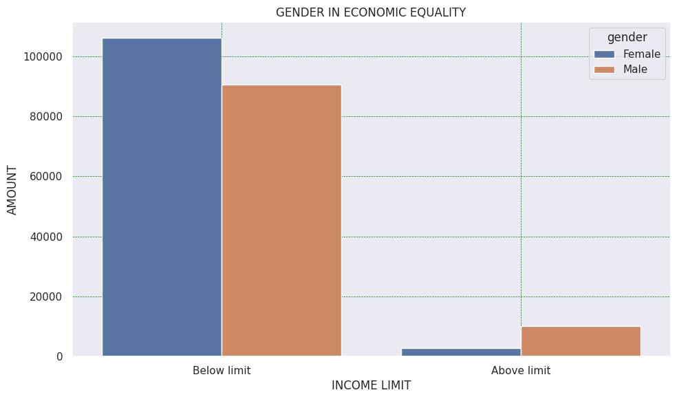
DISTRIBUTION OF INCOME LIMIT BY GENDER
There are more female than male earning below the income limit
On the contrary, more males earn above the income limit compared to females.

Slide 22
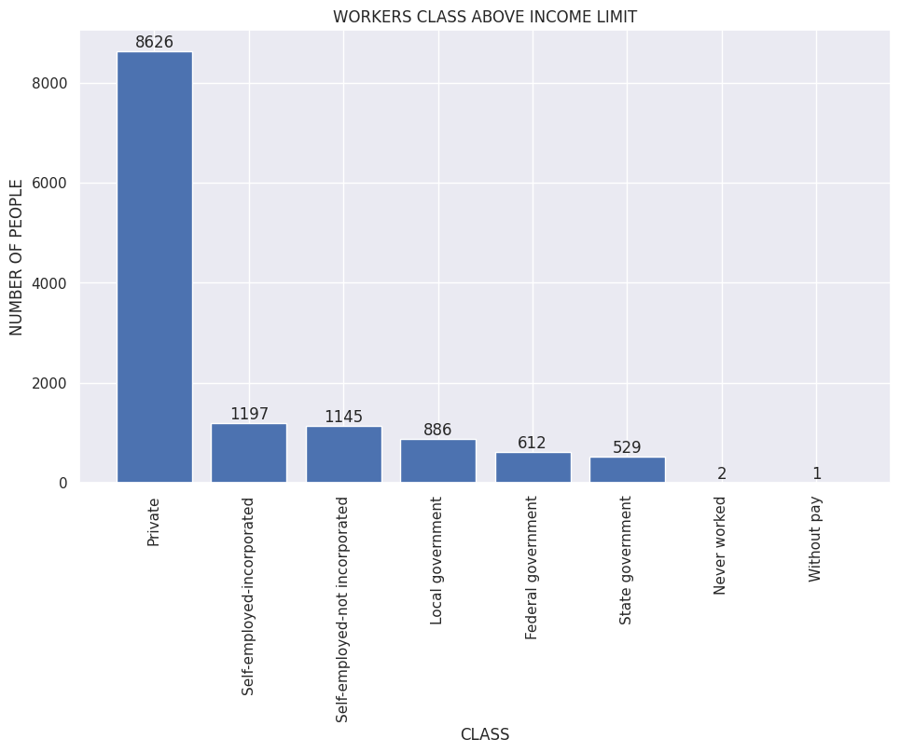
DISTRIBUTION OF WORKERS’ CATEGORY ABOVE INCOME LIMIT
The graph reveals that the highest number of people above the income limit are in the Private class, with 8626 people.
The lowest number of people above the income limit are in the Unemployed class, with only 1 person. The graph has labels and a legend.

Slide 23
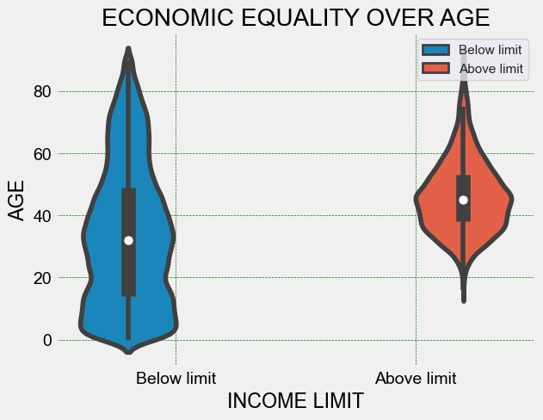
DISTRIBUTION OF INCOME LIMIT BY AGE
The violin plot compares income inequality ('above income limit' and 'below income limit') to age.
It reveals that the 'below income limit' group has a skewed income distribution, a lower median age.
It suggests a notable economic equality gap between the two groups.

Slide 24
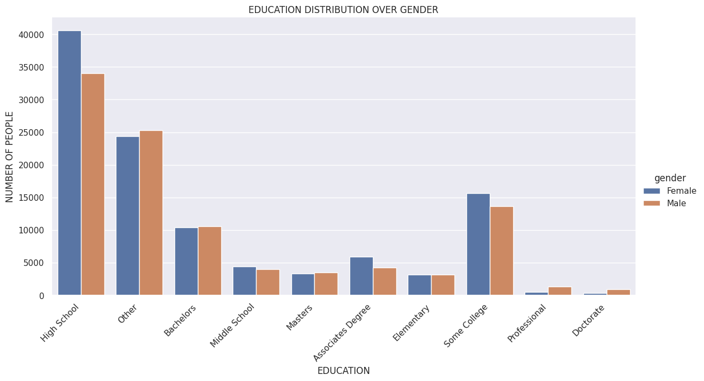
DISTRIBUTION OF EDUCATION BY GENDER
In the majority of the population, most individuals completed only high school education, with a higher proportion being female.
However, a larger percentage of males, in comparison to females, pursued advanced degrees at the Professional and Doctorate levels.

Slide 25
HYPOTHESIS TESTING
First Test
Null Hypothesis : There is no significant difference between Income limit and education level.
Alternative Hypothesis : There is a significant difference between Income limit and education level.
Result
The p-value is less than zero, which means that there is no chance of observing such a large difference if the null hypothesis were true.
Therefore, you can reject the null hypothesis and conclude that there is a significant difference between the two groups.

Slide 26
HYPOTHESIS TESTING
Second Test
Null Hypothesis : There is no significant relation between Income limit and education status. Status of education can not affect income limit.
Alternative Hypothesis : There is a significant relation between Income limit and education status. Status of education can affect income limit.
Result
The p-value is less than zero, which means that there is no chance of observing such a large difference if the null hypothesis were true.
Therefore, you can reject the null hypothesis and conclude that there is a significant difference between the two groups.

Slide 27
DATA PREPARATION

Slide 28
DATA PREPARATION
Data Cleaning
Action taken :
Identifying and Handling Missing Values
Replacing "NA" values in column
Replacing null values with the most frequent one
Dropping columns having more than 80% of null values

Slide 29
DATA PREPARATION
Feature Scaling
Action taken :
Selecting Numerical and Categorical Columns
Creating Pipelines for Imputing and Encoding
Applying Column Transformer for Data Transformation
Encoding the Training Data
Balancing the Data using SMOTE
Data Split: 80% Training, 20% Testing

Slide 30
MODELING

Slide 31
MODELING
Models Choosen : CatBoost, XGBoost, LightGBM, Decision Trees, Random Forest, Gradient Boosting Classifier.
Justification For Selection : These models were selected for their ability to handle categorical data and robust performance.

Slide 32
MODELING
MODEL TRAINING
Training Process : Models were trained using the provided dataset.
Cross-Validation : Cross-validation was performed for model assessment.
Data Preprocessing
Load Data
Split Data
Hyperparameter Tuning
Train Model
Cross-validation
Evaluate Model

Slide 33
MODELING
Performance Metrics : Catboost is selected from all models.
MODEL NAME | F1Score (%) | RMSLE
CatBoost | 97.63 | 0.107
XGBoost | 93.20 | 0.177
LightGBM | 96.60 | 0.129
Random Forest | 97 | 0.113
Decision Trees | 95 | 0.153
Gradient Boosting Classifier | 94 | 0.170

Slide 34
DEPLOYMENT

Slide 35
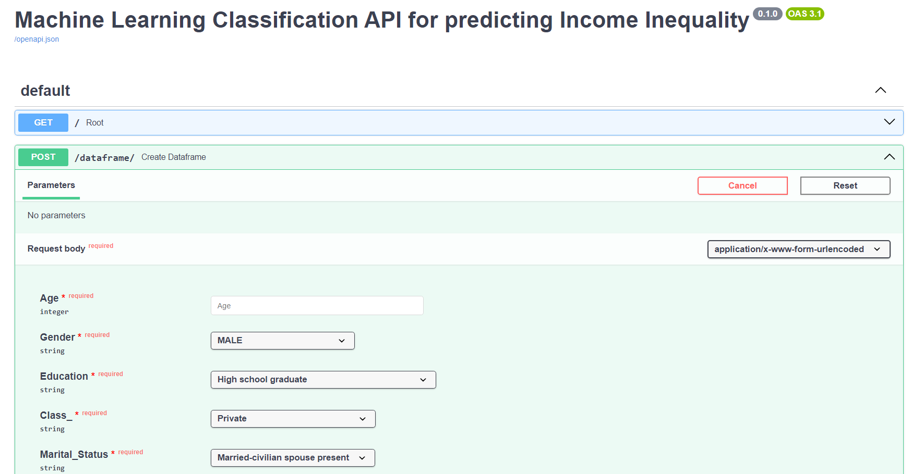
DEPLOYMENT

Slide 36
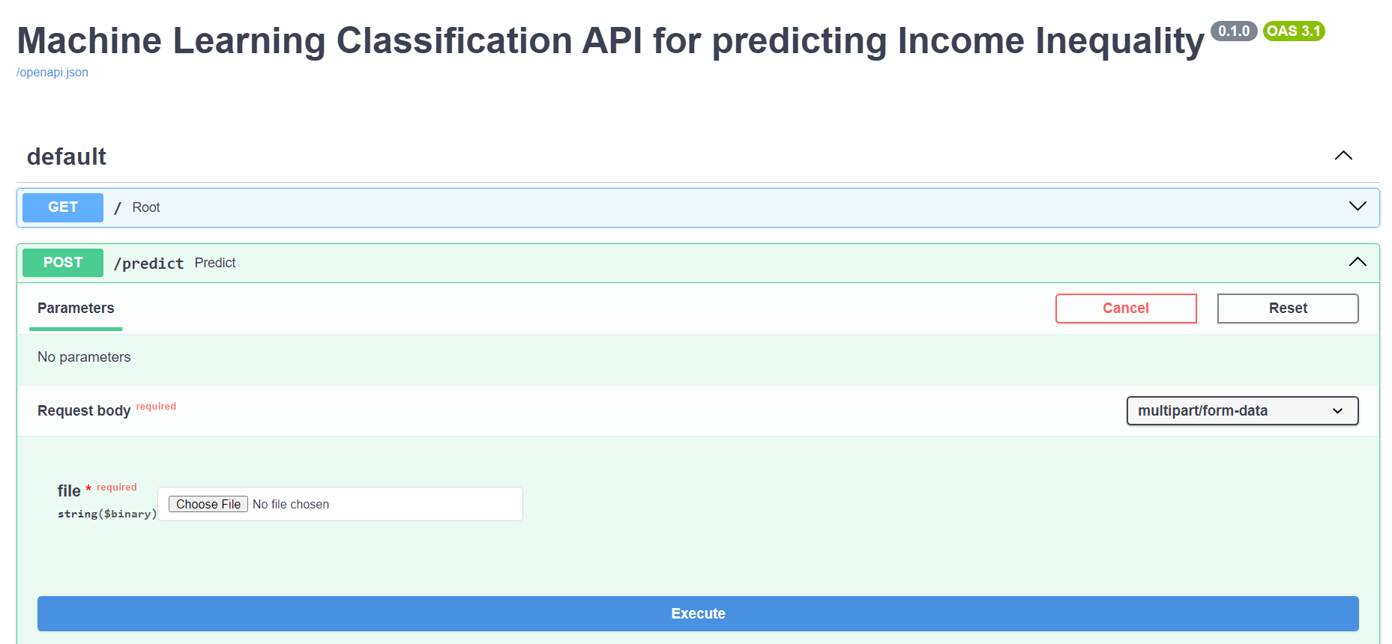
DEPLOYMENT

Slide 37
LINKS
https://henok21-economic-inequality.hf.space/docs
https://henok21-economic-inequality-loader.hf.space/docs

Slide 38
HAPPY CODING…

